Slide 1


Project 1 – Branch Prediction CS6304 Computer Architecture
Chih-An Chang , William Chang,
CXC210017, CXC200006
Department of Computer Science

Slide 2
Outline
Branch Prediction Introduction & Background
Gem5 Branch Predictors
Introduction
Setup
Configuration
Gem5 Branch Predictors Results
Benchmark Results
Result Discussion

Slide 3
Branch Prediction
Introduction & Background
Overview
What is brach prediction?
Why it is important?

Slide 4

Branch Prediction
Guess the next fetch address to be used in the next cycle

Slide 5




3 Things to be predict at Fetch stage
Fetched instruction is a branch ?
(Conditional) Branch Direction
Branch target address (if taken)

Slide 6



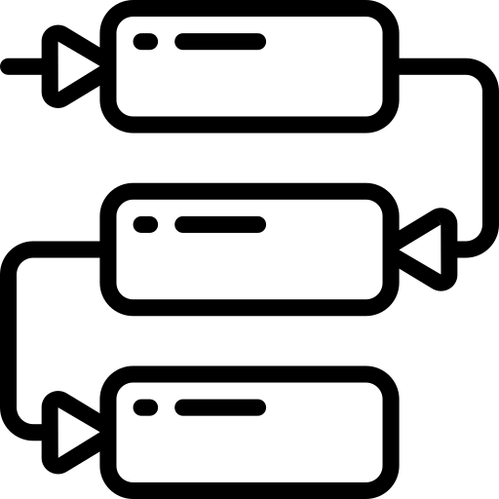

01
To handle control dependencies
Why it so important?
02
To speed execution of instructions on processors that use pipelining
03
To keep pipeline full of correct sequence of dynamic instructions
04
Very important to the performance of a deeply pipelined processor

Slide 7
Gem5 Branch Predictors
Overview
Introduction
Setup
Configuration

Slide 8

Gem5 Simulator
Open-source modular platform for system architecture research
Discrete- event simulation platform with numerous models
Most of gem5's code is written in C++ and Python.

Slide 9
1
Local Predictor
2bit Local Branch Predictor
Capturing the actual history of the specific branch and use that to make our prediction
A table will record branch is being taken or not taken
Trade-off: Easy to implement but miss predict rate is high
Types of Gem5
Branch Predictor
2
Bi-Mode Predictor
Global Behavioral Branch Predictor
Capturing the sequential correlation between branches
It aims to eliminate the destructive aliasing that occurs when two branches of opposite biases share the same global history pattern.
Trade-off: higher accuracy than local predictor but more complex to implement.
3
Tournament Predictor
Combined/Hybrid Predictor
Make multiple predictions and choose the right prediction based on the context of the particular branch
It has a local predictor and a global predictor
A choice predictor chooses between the two
Trade-off: Better accuracy but longer access latency

Slide 10
Local Predictor
Bi-Mode Predictor
Tournament Predictor
Global
Hybrid
Previous
Branch A
Previous
Branch A
Local
Predictor
Global
Predictor
B
…
x
Predict
Branch A
Predict
Branch A
Predict
Branch A

Slide 11




4 Things we have done
Setup
Adding BP
Adding Parameter
BP Comparing
Set up Gem5 simulation environment
Adding Branch Predictor to Timing Simple CPU
Adding extra Resulting Parameter in the Stats.txt file
Running the benchmarks and comparing different branch predictor

Slide 12
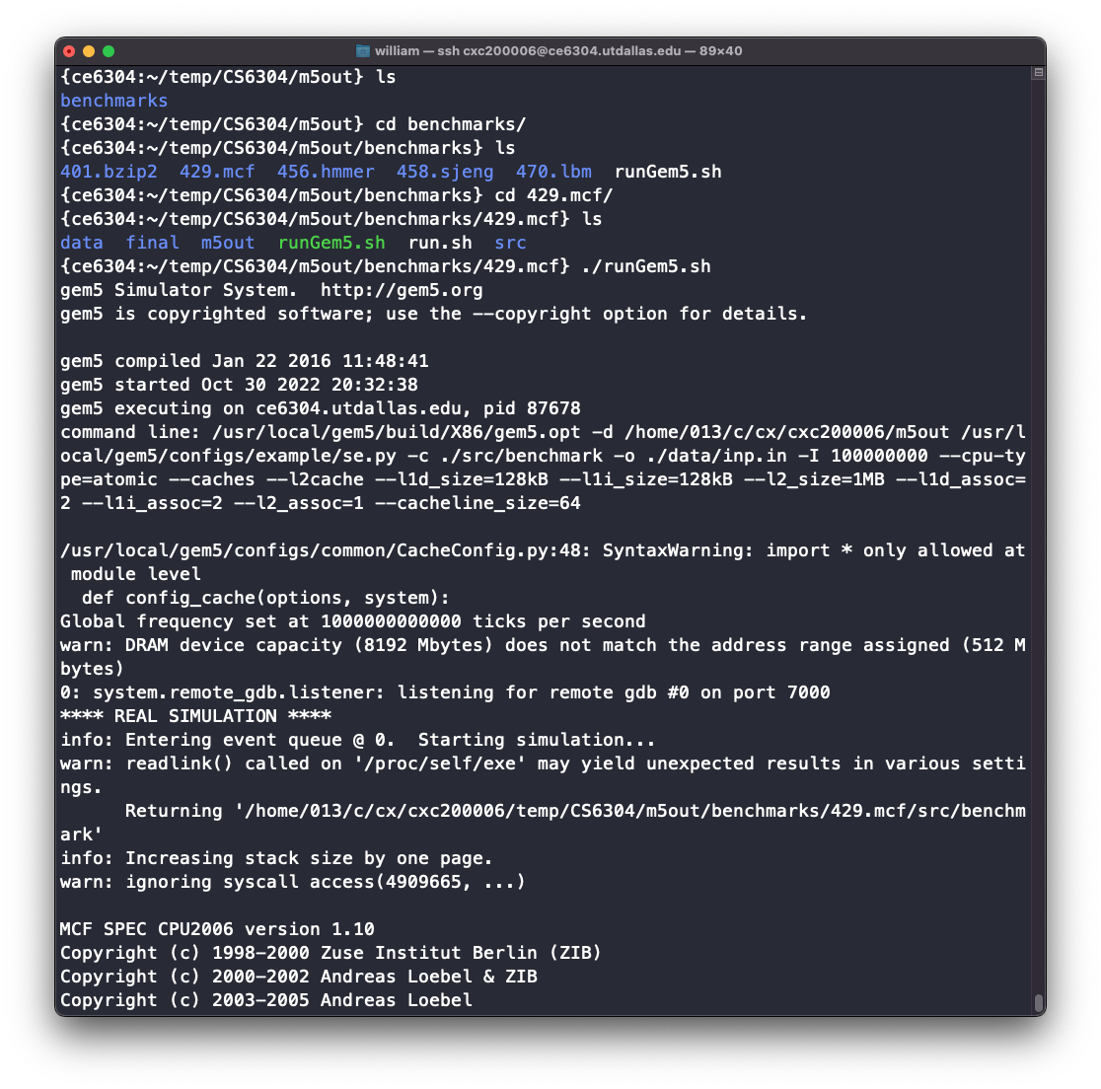
1. Gem5 Setup
1
Login to CE6304 linux server
ssh <net-id>@ce6304.utdallas.edu
2
Copy gem5 folder to your local directory
cp –rf /usr/local/gem5 /home/<netid>/<proj_folder>
3
Downloads the Benchmarks
git clone https://github.com/timberjack/Project1_SPEC
4
Building Gem5 X86 with Scons
scons build/X86/gem5.opt –j5
5
Give permission to run the script
chmod +x ./runGem5.sh

Slide 13



2. Adding Branch Predictor
Go to file
$gem5/src/cpu/simple/BaseSimpleCPU.py
At the bottom of file, you will see
branchPred = Param.BranchPredictor(Null, "Branch Predictor")
Change the “NULL” to one of following Branch Predictor
branchPred = Param.BranchPredictor(LocalBP(), "Branch Predictor")
branchPred = Param.BranchPredictor(BiModeBP(), "Branch Predictor")
branchPred = Param.BranchPredictor(TournamentBP(), "Branch Predictor")

Slide 14
3. Adding extra Resulting Parameter
Go to file
$gem5/$Gem5/src/cpu/pred/bpred_unit.cc
Implement BTBMissPct
void
BPredUnit::regStats()
{
. . . . . .
/* Implement BTBMissPct */
BTBMissPct
.name(name() + ".BTBMissPct")
.desc("BTB Miss Percentage")
.precision(6);
BTBMissPct = (1 - (BTBHits / BTBLookups)) * 100;
/* Implement BTBMissPct */
. . . . . }

Slide 15

Go to file
$gem5/$Gem5/src cpu pred bpred_unit.hh
Add the following declaration for BTBMissPct
Stats::Scalar BTBCorrect;
/** Stat for percent times an entry in BTB found. */
Stats::Formula BTBHitPct;
/* Add the following declaration */
/** Stat for percent times an entry in BTB miss. */
Stats::Formula BTBMissPct;
/** Stat for number of times the RAS is used to get a target. */
Stats::Scalar usedRAS;
/** Stat for number of times the RAS is incorrect. */
Stats::Scalar RASIncorrect;

Slide 16


Go to file
$gem5/$Gem5/$Gem5/src/cpu/simple/base.cc
Implement BranchMispredPercent
void
BaseSimpleCPU::regStats()
{
using namespace Stats; BaseCPU::regStats();
for (ThreadID tid = 0; tid < numThreads; tid++) {
. . . . .
// Implement BranchMispredPercent
t_info.BranchMispredPercent
.name(thread_str + ".BranchMispredPercent")
.desc("Percentage of Branch Mis-Predicts")
.prereq(t_info.BranchMispredPercent);
t_info.BranchMispredPercent =
(t_info.numBranchMispred / t_info.numBranches)*100;
// Implement BranchMispredPercent
}
}

Slide 17


Go to file
$gem5/$Gem5/src/cpu/simple/exec_context.hh
Add the following declaration for BranchMispredPercent
class SimpleExecContext : public ExecContext {
public:
. . . . . . . . . . . .
// Modify
Stats::Formula BranchMispredPercent;
. . . . . . . . . . . .
}

Slide 18

Gem5 Branch Predictors Results
Overview
Tournament Predictor

Slide 19
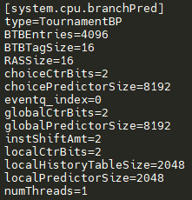
Result of CONFIG.INI FOR TournamentBP
Branch Predictor type has been changed to TournamentBP

Slide 20

Overview
Branch Predictor Exploration
Benchmark Results

Slide 21
BTBMissPct and BranchMispredPercent on each BP
 | BTBMissPct(%) |  | BranchMispredPercent (%)
 | 401.bzip2 | 429.mcf | 401.bzip2 | 429.mcf
local BTBEntries=2048 localPredictorSize=1024 | 0.0363 | 9.303 | 1.07 | 6.5322
TournamentBP BTBEntries=2048 localPredictorSize=1024 globalPredictorSize=4096 choicePredictorSize=4096 | 2.0578 | 31.9462 | 1.064 | 0.9698
BiModeBP BTBEntries=2048 globalPredictorSize=2048 choicePredictorSize=2048 | 0.0065 | 5.9759 | 1.1534 | 2.2625

Slide 22
Comparing results between 3 different branch predictors
All predictors have similar performance for 401.bzip2 benchmark
With given parameters, the BTB Entries for TournamentBP is not sufficient. Therefore, the BTBMissPct of TournamentBP is very high
From the BranchMispredPercent(429.mcf) point of view, TournamentBP > BiModeBP > LocalBP
Conclusion:
Although TournamentBP has the potential to have the highest overall accuracy, it needs enough resources to make it work.
The choice of branch predictor is important. For some types of programs, selecting localBP can save resources while getting high accuracy.

Slide 23
Exploration - BTBEntries on LocalBP
1024 BTB entries is enough for benchmark 401.bzip2
Needs 4096 BTB entries for 429.mcf

Slide 24
Exploration – Local Predictor size on LocalBP
Local predictor size of 512 bytes is large enough for both 401.bzip2 and 429.mcf
Increasing the size of local predictor size does not improve BTBMissPct nor BranchMispredPercent significantly
The best configuration for local predictor would be
BTB entries: 4096
Local predictor size: 512

Slide 25
Exploration – BTB Entries in BiModeBP
1024 BTB entries is sufficient for 401.bzip2
429.mcf needs 4096 BTB entries

Slide 26
Exploration – Predictor sizes on BiModeBP
Increasing global and choice predictor size from 1024 to 2048 greatly reduce BTBMissPct by 5.3% for 429.mcf
Increasing global and choice predictor size after 2048 does not have significant impact.
The best configuration for TournamentBP would be
BTB entries: 4096
Global predictor size: 2048 (or 8192)
Chois predictor size: 2048 (or 8192)

Slide 27
Exploration – BTB Entries on TournamentBP
1024 BTB entries is large enough for 401.bzip2
Increasing BTB entries from 4096 to 8192 can significantly improve BTBMissPct

Slide 28
Exploration – Predictor sizes on TournamentBP
Increasing global and choice predictor size from 2048 to 4096 reduce BTBMissPct by 1.4% for 429.mcf
Increasing local predictor size from 2048 to 4096 reduce BranchMispredPercent by 0.29% for 429.mcf
The best configuration for TournamentBP would be
BTB entries: 8192
Local predictor size: 4096
Global predictor size: 4096
Chois predictor size: 4096

Slide 29
BTBMissPct and BranchMispredPercent on each BP (Comparing our new config with the given params)
BP Type | Params | BTBMissPct(%) |  | BranchMispredPercent (%)
 |  | 401.bzip2 | 429.mcf | 401.bzip2 | 429.mcf
localBP | Given | 0.036 | 9.303 | 1.070 | 6.532
 | New | 0.036 | 7.852 | 1.070 | 5.964
TournamentBP | Given | 2.058 | 31.946 | 1.064 | 0.970
 | New | 2.054 | 1.552 | 1.065 | 0.087
BiModeBP | Given | 0.007 | 5.976 | 1.153 | 2.263
 | New | 0.006 | 4.506 | 1.154 | 1.694

Slide 30

Result Discussion
Overview
Conclusion

Slide 31
Conclusion
For benchmark 401.bzip2
LocalBP = TournamentBP > BiModeBP
Benchmark 401.bzip2 is an image compression program. Therefore, we can imagine it repeatedly runs the same piece of code for compression on different sectors of the image. The branch behavior should be more monotonous, and the local correlation should be more significant in 401.bzip2. We think that’s the reason why LocalBP and TournamentBP perform better than BiModeBP in this scenario.
The number of branches in a compression program should be fewer as well. Hence, it also requires fewer BTBentries for all three branch predictors.

Slide 32
Conclusion
For benchmark 429.mcf
TournamentBP > BiModeBP > LocalBP
Benchmark 429.mcf runs public transportation scheduling algorithm. The complexity of the algorithm in 429.mcf should be higher than 401.bzip2. In a scheduling problem, A change of one vehicle’s schedule will affect the schedule of the others, so it is more of a global correlation problem. Thus, TournamentBP and BiModeBP perform better in 429.mcf.
We imagine the architecture of a scheduling algorithm should have many if else statements to cope with different scenarios. Therefore, it is reasonable that scheduling algorithm requires more BTB entries than the compression algorithm.

Slide 33

Thank you

